Slide 1
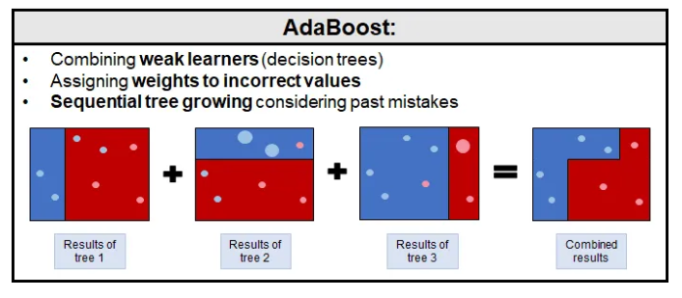
AdaBoost (Adaptive Boosting) is an ensemble learning method that combines multiple weak learners to create a stronger model.

Slide 2
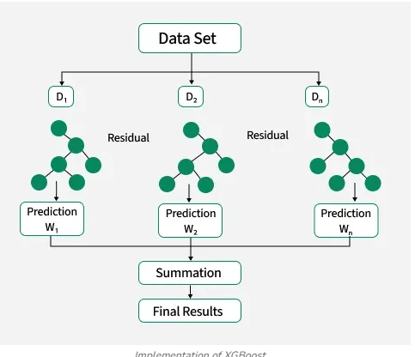
building an ensemble of decision trees sequentially where each new tree corrects the errors made by the previous one. It uses advanced optimization techniques and regularization methods that reduce overfitting and improve model performance.

Slide 3
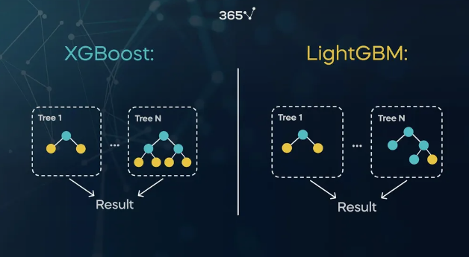
LGBM tree grows leaf-wise, while the XGBoost algorithm tree grows depth-wise:

